Slide 1

Black-Scholes model
PRESENTED BY SHARATH

Slide 2
Introduction
The Black-Scholes model, also known as the Black-Scholes-Merton (BSM) model, is one of the most important concepts in modern financial theory. This mathematical equation estimates the theoretical value of derivatives based on other investment instruments, taking into account the impact of time and other risk factors. Developed in 1973, it is still regarded as one of the best ways for pricing an options contract.
The Black-Scholes model requires five input variables: the strike price of an option, the current stock price, the time to expiration, the risk-free rate, and the volatility.

Slide 3
How does it work
Black-Scholes posits that instruments, such as stock shares or futures contracts, will have a lognormal distribution of prices following a random walk with constant drift and volatility. Using this assumption and factoring in other important variables, the equation derives the price
the model predicts that the price of heavily traded assets follows a geometric Brownian motion with constant drift and volatility
the model predicts that the price of heavily traded assets follows a geometric Brownian motion with constant drift and volatility
No dividends are paid out during the life of the option.
Markets are random (i.e., market movements cannot be predicted).
There are no transaction costs in buying the option.
The risk-free rate and volatility of the underlying asset are known and constant.
The returns of the underlying asset are normally distributed.
The option is European and can only be exercised at expiration.

Slide 4
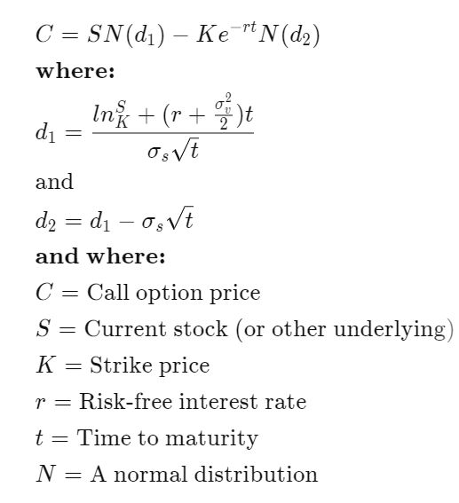
Black scholes Formula

Slide 5
Volatility Skew
Black-Scholes assumes stock prices follow a lognormal distribution because asset prices cannot be negative (they are bounded by zero).
Often, asset prices are observed to have significant right skewness and some degree of kurtosis (fat tails). This means high-risk downward moves often happen more often in the market than a normal distribution predicts
The assumption of lognormal underlying asset prices should show that implied volatilities are similar for each strike price according to the Black-Scholes model. However, since the market crash of 1987, implied volatilities for at-the-money options have been lower than those further out of the money or far in the money. The reason for this phenomenon is the market is pricing in a greater likelihood of a high volatility move to the downside in the markets.

Slide 6
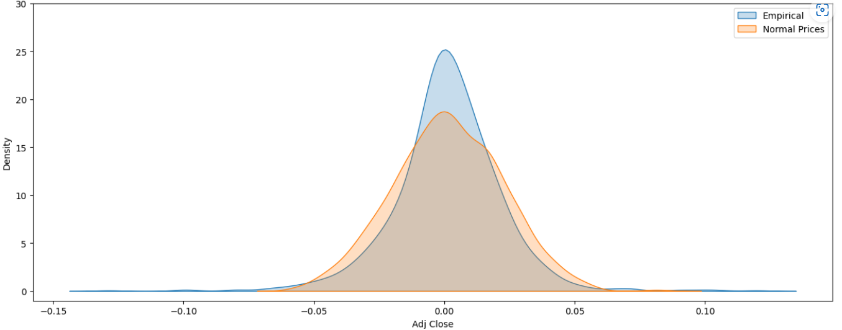
Limitation's of Black scholes model
This model was built on the assumption that stock prices are log-normally distributed. Log-normal distributions of prices implies normal distributions of returns. However, empirically this is not the case. There occur large price spikes in markets due to unprecedented events, creating a fat-tailed distribution for returns which differs from normal
Black-Scholes model is only used to price European options and does not take into account that American options could be exercised before the expiration date. Moreover, the model assumes dividends, volatility, and risk-free rates remain constant over the option's life.
Not taking into account taxes, commissions or trading costs or taxes can also lead to valuations that deviate from real-world results.

Slide 7
Conclusion
The Black Scholes model was a turning point for the options world who finally had a mathematical foundation to build their options portfolios.
The Black Scholes model also gave rise to a number of option hedging strategies which are still being implemented today
.

